Slide 1
Chapter 2 Configuration Space
Chapter 3 Rigid-Body Motions
Chapter 4 Forward Kinematics
Chapter 5 Velocity Kinematics and Statics
Chapter 6 Inverse Kinematics
Chapter 7 Kinematics of Closed Chains
Chapter 8 Dynamics of Open Chains
Chapter 9 Trajectory Generation
Chapter 10 Motion Planning
Chapter 11 Robot Control
11.1 Control System Overview
11.2 Error Dynamics
11.3 Motion Control with Velocity Inputs
11.4 Motion Control with Torque or Force Inputs
Chapter 12 Grasping and Manipulation
Chapter 13 Wheeled Mobile Robots

Slide 2
Important concepts, symbols, and equations
Proportional-Integral-Derivative (PID) control

Slide 3
Important concepts, symbols, and equations (cont.)

Slide 4
Important concepts, symbols, and equations (cont.)
Setpoint PD control, g = 0
= 0
For what gains
are the error
dynamics stable?

Slide 5
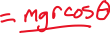
Important concepts, symbols, and equations (cont.)
Setpoint PD control, g ≠ 0
Nonhomogeneous.
What is the steady-
state error?

Slide 6
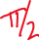
Important concepts, symbols, and equations (cont.)
𝜃_{d} = 0
𝜃(0) = −𝜋/2

Slide 7
Important concepts, symbols, and equations (cont.)
Setpoint PID control, g ≠ 0
dist

Slide 8
Important concepts, symbols, and equations (cont.)
root locus for
K_{p}, K_{d} constant
and K_{i} increasing
from zero
K_{i} improves steady-state
response but can worsen
the transient response.

Slide 9
Important concepts, symbols, and equations (cont.)

Slide 10

Important concepts, symbols, and equations (cont.)
What about tracking general trajectories, not just setpoint control?

Slide 11
Important concepts, symbols, and equations (cont.)
Computed torque control (feedback linearization)
for a single joint
or multi-joint
robots

Slide 12
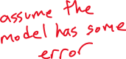
Important concepts, symbols, and equations (cont.)

Slide 13
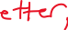
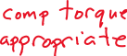
Important concepts, symbols, and equations (cont.)
Task-space computed torque control
What if your dynamic
model is poor?

Slide 14
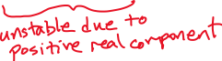
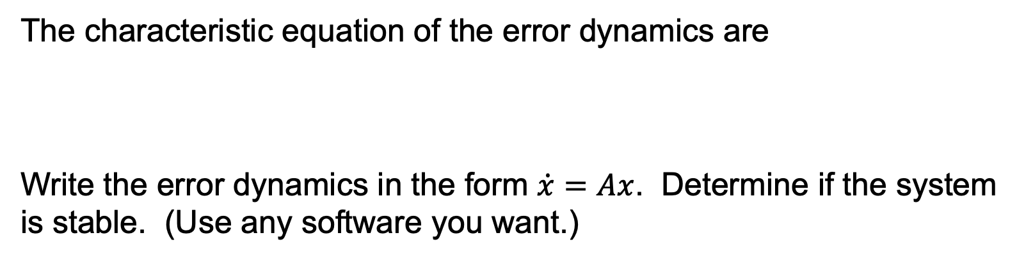
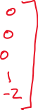
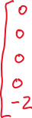
The characteristic equation of the error dynamics are
Write the error dynamics in the form $\dot{x}=Ax$. Determine if the system
is stable. (Use any software you want.)

